Slide 1
Insights from an Updated Computational Model of Early Mathematical Knowledge and Skill
3+4=5
Menon Lab: Christian, Lang, Shaozheng, Tanya
Interns: Archer, Eric, Myra, Roujia
SymSys: Jeff
REMEMBER TO TURN ON RECORDER FOR ARCHER AND MYRA!

Slide 2
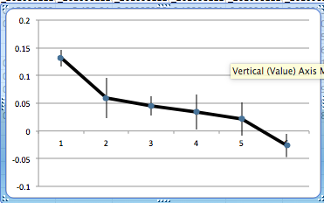
Where We’re Going

Slide 3
Outline
Goals:
Insight on early math from computational modeling
Why early math?
It’s universal and clear.
Interaction between brain, language, and math development
A brief (biased) history of computational models of math development
Approach:
Dual Neural Nets: Linguistic and Mathematical
Method Details
Results

Slide 4

What It’s All About

Slide 5
Major Behavioral Steps toward Understanding Number
Flexible Number
Knowledge
Counting
Single digit addition
Number Naming
0-2 Years
2-4 Years
4-6 Years

Slide 6
Goals
Update computational models of mathematical development that have languished since the mid 1990s, and so haven’t benefited from two decades of brain science, esp. systems neuroscience and deep learning (esp. re timing).
See what insights into early math we can gain from a Systems Neuroscience approach, and also by carefully thinking through the systems neuroscience and developmental timing of the problem (i.e., deep learning).
Broaden these models to encompass earlier aspects of mathematical development as it interact with models of language development and of brain development.

Slide 7
Properties of a Good Computational Model
Useful computational models uncover deep organizational principles of a system, achieved by balancing simplicity with situation-specific accuracy.
Models should strive for simplicity, reaching beyond the confusing diversity of reality to identify key causal components, explicitly choosing which parts of reality, and which assumptions, to include or exclude.
Simplification furthers the development of an explanatory framework that generalizes across a range of phenomena.
Models should not be abandoned if they are unsuccessful; Understanding why a well-specified model does not work as predicted can be profoundly useful. Failures should provide the impetus for an iterative process of updating, leading to novel experiments and further model development.
C Teufel & PC Fletcher. The promises and pitfalls of applying computational models to neurological and psychiatric disorders. Brain (2016)

Slide 8
The research programme:
The development of simple math as a clear setting.
Simple addition ain’t so simple!
Early Model: A competing “fast”/“slow” architecture.
Late Early Model: Strategy choice.
Middle Model: Strategy Change.
Current Model: Based on “Systems Neuroscience”.
Our approach: “Progressive Deeping” NN architecture that builds later-learned “high” level concepts from earlier-learned “low” level ones.

Slide 9
Why Early Math?
Math is universal.
Math has relatively clear behavioral correctness criteria that is easily measurable, as are errors.
Math has clear theoretical semantics.
There is probably more data around just ten symbols than around any other human practice!

Slide 10
Simple Math Ain’t so Simple!
Even simple mathematical practices can be surprisingly complex, involving the entire brain, body, and physical environment.
Math comes in so early that it interacts with language and brain development in highly complex ways.
It is very difficult to study brain development this early, so it must be largely imputed.

Slide 11
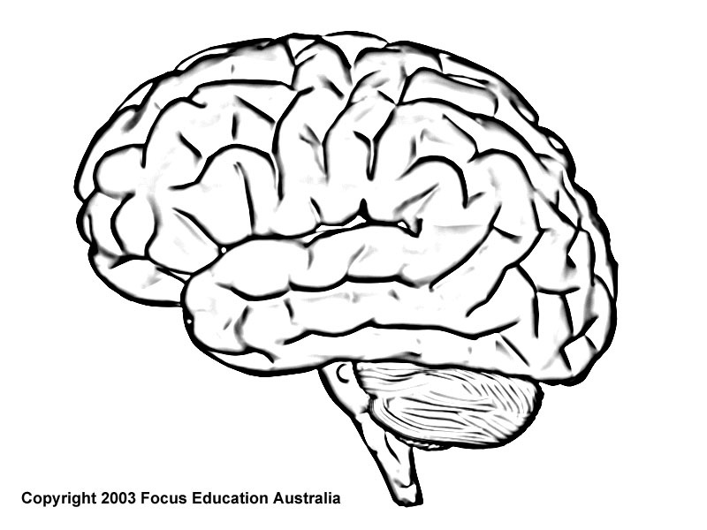


How Complex Strategies Work in the Brain and in the World
General Motor: Finger activity and cognitive skill sequencing
General Frontal: Activity initiation and in-process/attentional control
Motor Fingers
IPS: Number concept; possibly the primary NN hidden layer
QuasiMotor Attention
Internal Number
Hippocampus: Explicit number fact memory
Strategy Sequencing
Echoic Memory
Visual Fingers
Phonetic Hearing
General Visual: Seeing fingers
General Auditory: Turning phonetics into internal representations, and possibly operating the echoic buffers
Cerebellum: Smooth (Cognitive skill) Sequencing
Phonetic Saying

Slide 12
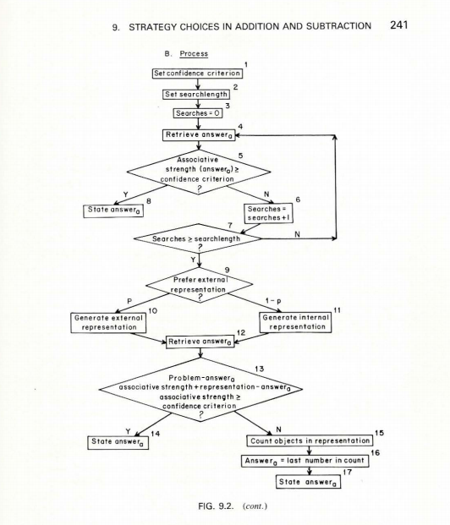
Earliest Strategy Choice Model
Siegler, R. S. & Shrager, J. (1984). Strategy choices in addition and subtraction: How do children know what to do? In C. Sophian (Ed.), Origins of cognitive skills. Erlbaum.

Slide 15
Earliest Strategy Choice Model
Siegler, R. S. & Shrager, J. (1984). Strategy choices in addition and subtraction: How do children know what to do? In C. Sophian (Ed.), Origins of cognitive skills. Erlbaum.

Slide 16
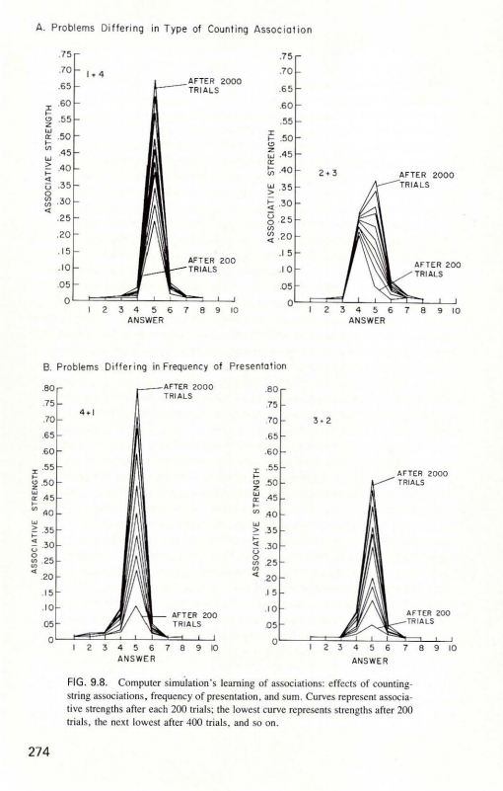
Earliest Strategy Choice Model

Slide 17
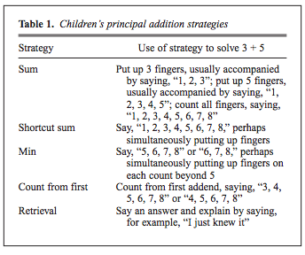
Strategy Change
Shrager, J. & Siegler, R. S. (1999). SCADS: A model of strategy choice and strategy discovery. Psychological Science.

Slide 18
Major Behavioral Steps toward Understanding Number
Flexible Number
Knowledge
Counting
Single digit addition
Number Naming
0-2 Years
2-4 Years
4-6 Years

Slide 19
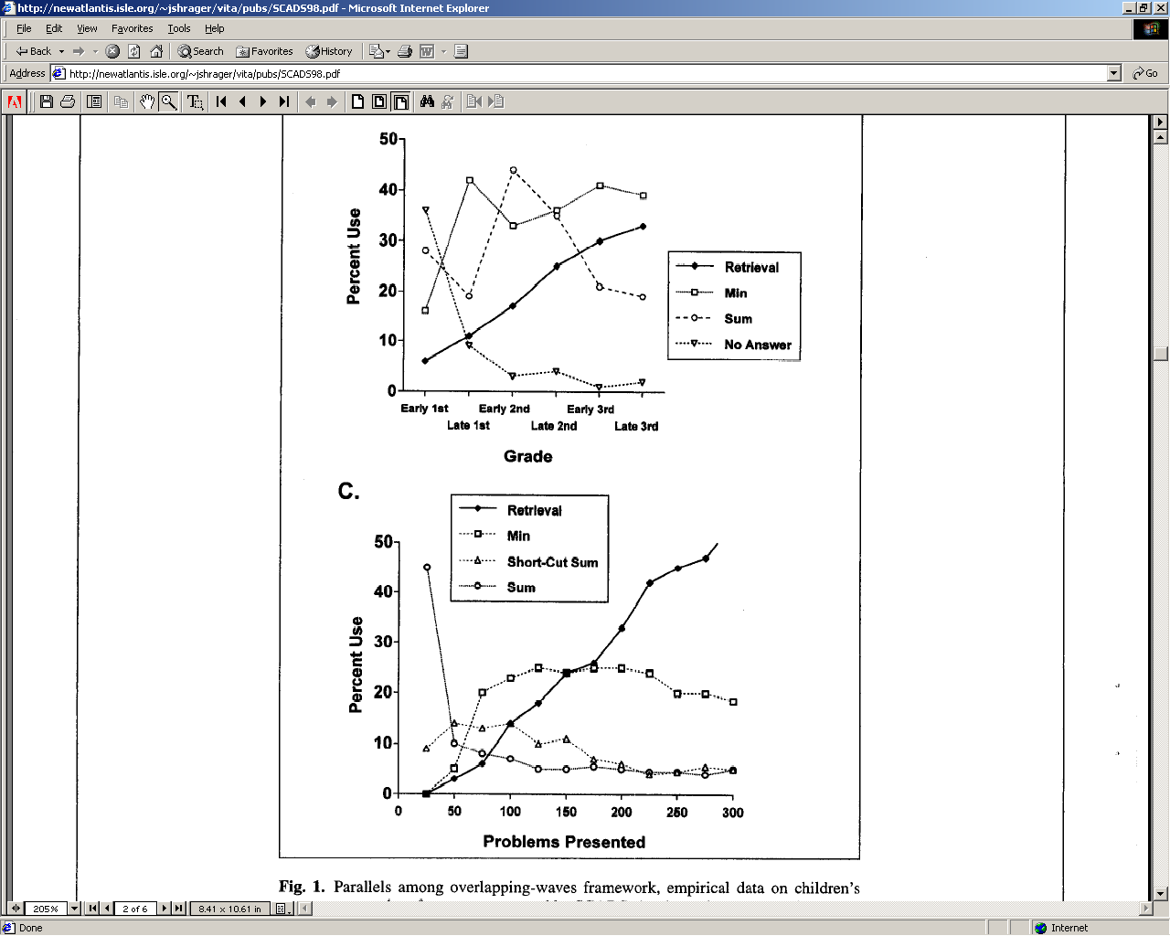
Strategy Change
Shrager, J. & Siegler, R. S. (1999). SCADS: A model of strategy choice and strategy discovery. Psychological Science.

Slide 20
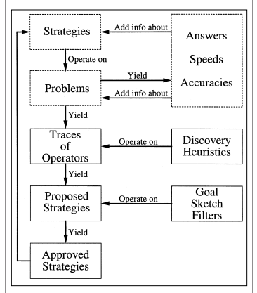
Strategy Change
Shrager, J. & Siegler, R. S. (1999). SCADS: A model of strategy choice and strategy discovery. Psychological Science.

Slide 21
Strategy Change
Shrager, J. & Siegler, R. S. (1999). SCADS: A model of strategy choice and strategy discovery. Psychological Science.

Slide 22
Strategy Change
The Problem:
Shrager, J. & Siegler, R. S. (1999). SCADS: A model of strategy choice and strategy discovery. Psychological Science.

Slide 23
Major Behavioral Steps toward Understanding Number
Counting
Single digit addition
Number Naming
0-2 Years
2-4 Years
4-6 Years

Slide 24
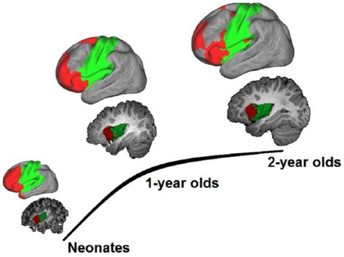
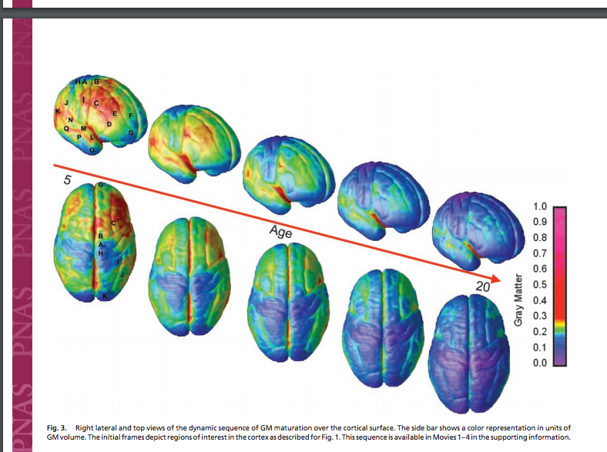
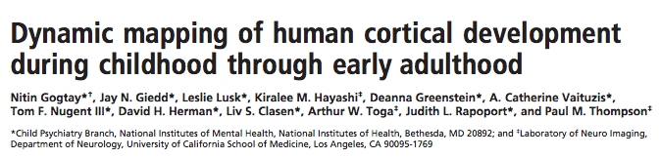
Interaction between math and brain in early development
Single digit addition
(up to 5+5)
Counting
Number Naming
0-2 Years
2-4 Years
4-6 Years
Functional Connectivity Plastic and Modifiable

Slide 25
Balance Simplicity with Situation-Specific Accuracy

Slide 26
Modeling Paradigm
General Motor: Finger activity and cognitive skill sequencing
General Frontal: Activity initiation and in-process/attentional control
Motor Fingers
IPS: Number concept; possibly the primary NN hidden layer
QuasiMotor Attention
Internal Number
Hippocampus: Explicit number fact memory
Strategy Sequencing
Echoic Memory
Visual Fingers
Phonetic Hearing
General Visual: Seeing fingers
General Auditory: Turning phonetics into internal representations, and possibly operating the echoic buffers
Cerebellum: Smooth (Cognitive skill) Sequencing
Phonetic Saying

Slide 27
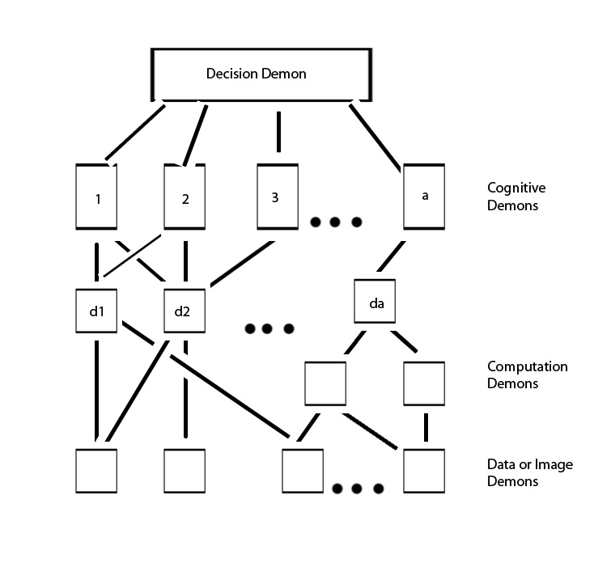
Selfridge’s (1959) Pandemonium Paradigm

Slide 28


Neural Net (NN) Paradigm (since the 1980s)
Pandemonium + Learning:
?????
“Three”
“Hand”
Output Layer
Trainable
cross-products
Hidden Layer
Input Layer

Slide 29
Dynamic Cortical Parcellation
"...the infant's brain seems to organize itself under the influence of waves of so-called trophic-factors ... different regions of the brain become connected sequentially, with one layer of tissue maturing before another and so on until the whole brain is mature.”
S. Blakeslee., "In brain's early growth, timetable may be critical," The New York Times, Science Section, pp. B5–B6, 1995.

Slide 30
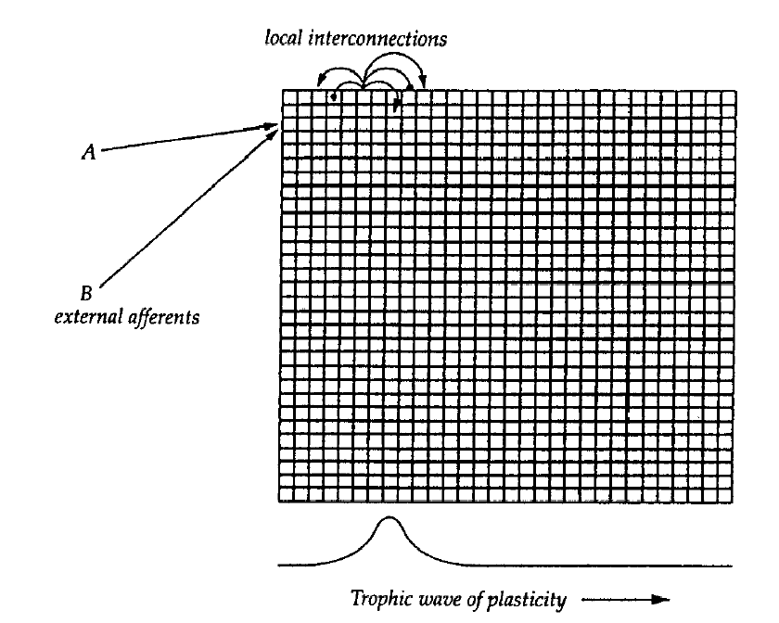
Cortical Parcellation
Shrager, J. & Johnson, M. H. (1996). Factors influencing the Elman, et al. (1999). Rethinking Innateness. MIT Press.
emergence of function in a simple cortical network.
Neural Networks, 9(6), 1119-1129.

Slide 31
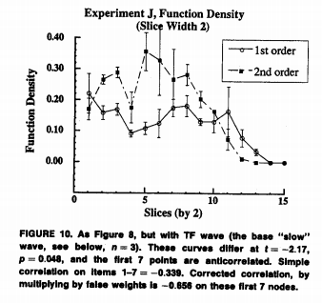
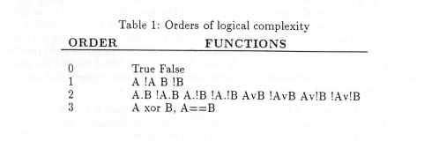
Cortical Parcellation
Shrager, J. & Johnson, M. H. (1996). Factors influencing the emergence of function in a simple cortical network. Neural Networks, 9(6), 1119-1129.

Slide 32
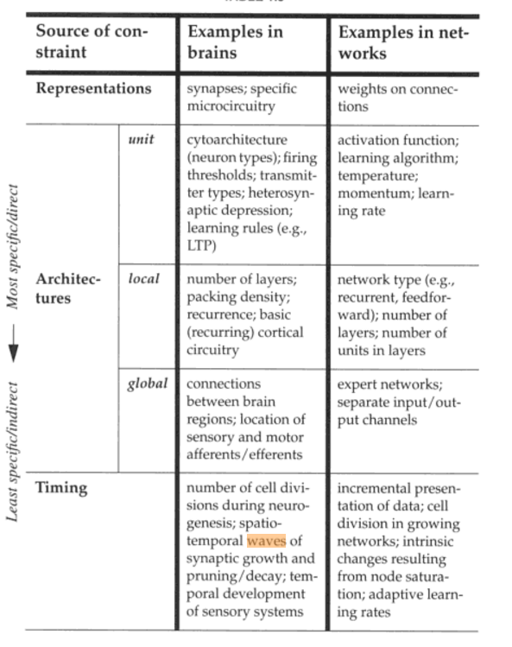

Slide 33
Earliest Strategy Choice Model
Single digit addition
(up to 5+5)
Counting
4-6 Years
“Addition” Network
Addition Results
Strategies
Addition Association Layer
Strategy Association Layer
Addend 1 number semanrtics
Addend 2 number semanrtics

Slide 36
Strategy: Count from one twice:
Put all fingers down; Pick a hand, Pick an addend, Say the addend, Clear the echoic buffer (EB), Raise <addend> finger on the attend hand,
Swap hands, Swap addends, Say the next addend, Clear the EB, Raise <addend> finger on the attend hand,
Pick a hand, Clear the EB, Count fingers, Swap hands, Count fingers,
Say the contents of the EB as the answer.
To raise <N> fingers on the attended hand:
Start C at 0.
Until C = N:
Say the next number from the EB,
Put up the attended finger,
Shift focus to the next finger,
Increment C.
Try again to retrieve an answer.
If you get one, put it in the EB, and stop.
To count fingers:
Until there are no more fingers to count:
Say the next number from the EB,
Shift focus to the next finger.
To say the next number from the EB:
If the EB contains 0, say 1,
Else choose a random number (R) between 0 and 1,
If R > the probability of error parameter,
Say EB + 1.
Otherwise, say the nearest confuser value of EB + 1.

Slide 37
Results
Non-Language Addition
Basic learning and strategy choice effects
Counting pretraining (interference) effect
(Error effect)
Language
Basic learning
Different representation/orthogonality
Combined Language → Addition
Same set of experiments with pre-trained language input

Slide 38
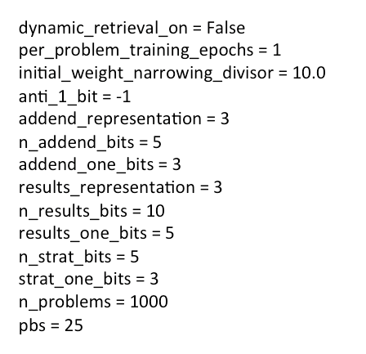
# SCANNED PARAMETERS: # NON-SCANNED PARAMETERS:
# Setting up the initial counting network
"initial_counting_network_burn_in_epochs": [1],
"initial_counting_network_learning_rate": [0.05],
# Problem presentation and execution
"DR_threshold": [1.0],
"PERR": [0.0],
# Choosing to use retrieval v. a strategy
"RETRIEVAL_LOW_CC": [0.60],
"RETRIEVAL_HIGH_CC": [0.61],
"STRATEGY_LOW_CC": [0.6],
"STRATEGY_HIGH_CC": [1.0],
# Learning target params
"strategy_hidden_units": [3],
"results_hidden_units": [10],
"strategy_learning_rate": [0.1],
"results_learning_rate": [0.05],

Slide 39
Earliest Strategy Choice Model
Single digit addition
(up to 5+5)
Counting
4-6 Years
“Addition” Network
Addition Results
Strategies
Addition Association Layer
Strategy Association Layer
Addend 1 number semanrtics
Addend 2 number semanrtics

Slide 40
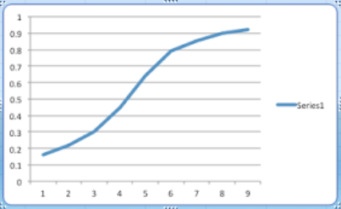
Basic Learning Result
Correlation Coef. (adult)
~1000 ~2000
Addition Problem Presentations

Slide 41
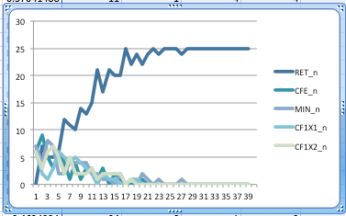
Basic Strategy Choice Result

Slide 42
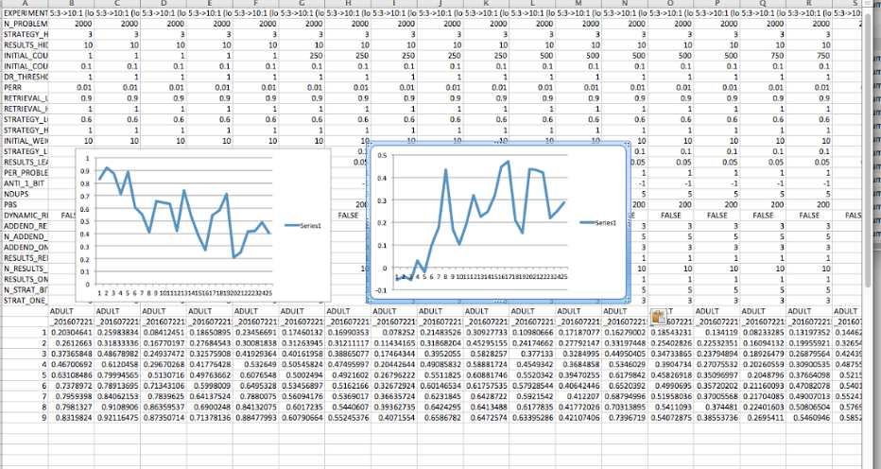
Counting Interference Effect
T2000 Adult
T0 Base Exact
Correlation Coef.
0(1) 250 500 750
Pre-Counting
0(1) 250 500 750
Pre-Counting
2016-07-22 at 3.55.09 PM

Slide 43
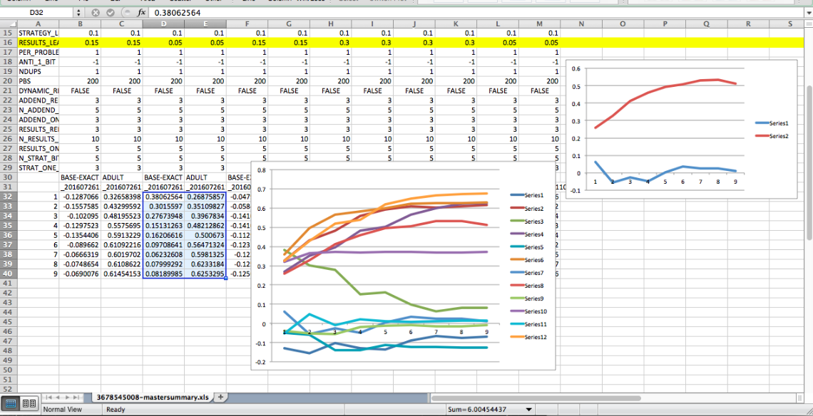
Counting Interference x Learning Rate
2016-07-26 at 11.15.56 AM

Slide 44
Results
Non-Language Addition
Basic learning and strategy choice effects
Counting pretraining (interference) effect
(Error effect)
Language
Basic learning
Different representation/orthogonality
Combined Language → Addition
Same set of experiments with pre-trained language input

Slide 45
Single digit addition
(up to 5+5)
Counting
Number Naming
0-2 Years
2-4 Years
4-6 Years
Non-number semanrtics
Number semantics
Addition Results
Strategies
Number and Language Association Layer
Addition Association Layer
Strategy Association Layer
Words (including both number and non-number)
Addend 1 number semanrtics
Addend 2 number semanrtics
“Language” network
Trained Early
“Addition” Network
Train Later

Slide 46
Dual Channel Representation of Object & Number
Non-number semanrtics
Number semantics
Number and Language Association Layer
Linguistic → [Semantic/Neural]
“Five” → [5]
v.
“Hand” → [hand]
Words (including both number and non-number)
“Language” network
Trained Early

Slide 47
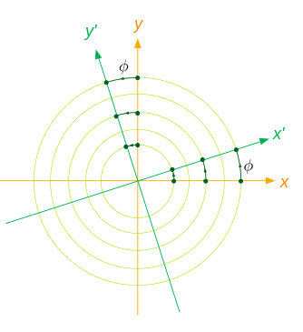
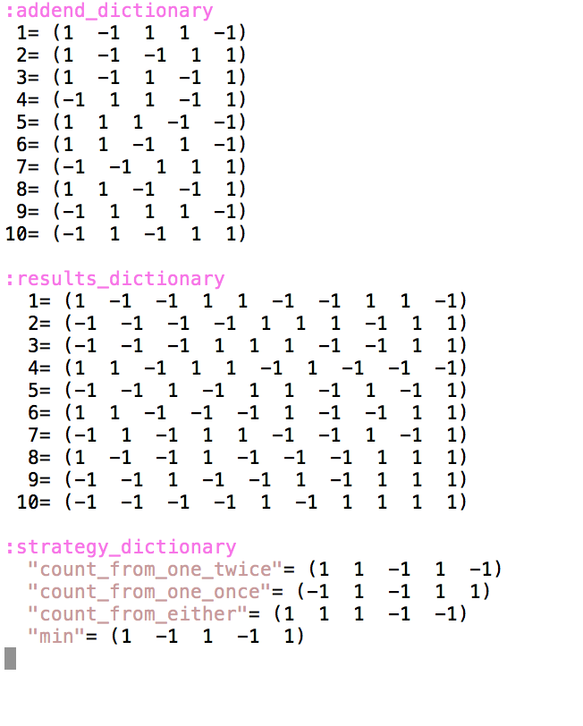
A Brief Foray into Representation

Slide 48
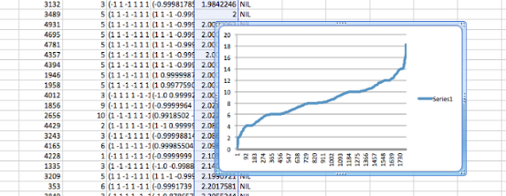
Learning to Name Numbers
Un-normalized delta
Total Presentations
(reverse – starts on right)
2016-08-03 at 1.02.36 PM

Slide 49
Results
Non-Language Addition
Basic learning and strategy choice effects
Counting pretraining (interference) effect
(Error effect)
Language
Basic learning
Different representation/orthogonality
Combined Language → Addition
Same set of experiments with pre-trained language input

Slide 50
Single digit addition
(up to 5+5)
Counting
Number Naming
0-2 Years
2-4 Years
4-6 Years
Non-number semanrtics
Number semantics
Addition Results
Strategies
Number and Language Association Layer
Addition Association Layer
Strategy Association Layer
Words (including both number and non-number)
Addend 1 number semanrtics
Addend 2 number semanrtics
“Language” network
Trained Early
“Addition” Network
Train Later

Slide 51
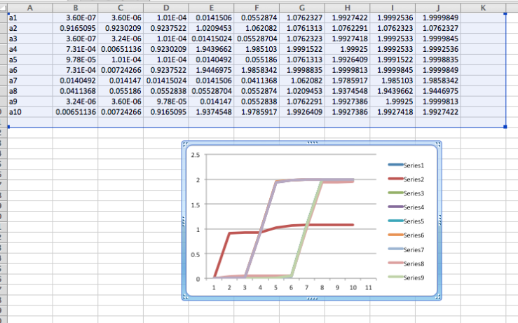
Actual Learned Differences
Un-normalized distance
Ranked nearest number
(== is leftmost)
2016-08-08 at 11.56.19 AM

Slide 52
Strategy: Count from one twice:
Put all fingers down; Pick a hand, Pick an addend, Say the addend, Clear the echoic buffer (EB), Raise <addend> finger on the attend hand,
Swap hands, Swap addends, Say the next addend, Clear the EB, Raise <addend> finger on the attend hand,
Pick a hand, Clear the EB, Count fingers, Swap hands, Count fingers,
Say the contents of the EB as the answer.
To raise <N> fingers on the attended hand:
Start C at 0.
Until C = N:
Say the next number from the EB,
Put up the attended finger,
Shift focus to the next finger,
Increment C.
Try again to retrieve an answer.
If you get one, put it in the EB, and stop.
To count fingers:
Until there are no more fingers to count:
Say the next number from the EB,
Shift focus to the next finger.
To say the next number from the EB:
If the EB contains 0, say 1,
Else choose a random number (R) between 0 and 1,
If R > the probability of error parameter,
Say EB + 1.
Otherwise, say the nearest confuser value of EB + 1.

Slide 53
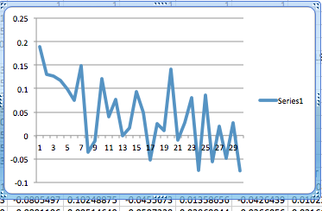
Combined Effects
Adult Correlation
0.0 0.02 0.04 0.06 0.08 0.10
p.Err
Adult add correlation (5000 problems) x p. counting error based on linguistic confusion set (3679932281)

Slide 54
Next Steps: More Detail in Counting
Make counting a first-class strategy (so that “say next” internal to counting inherits linguistic confusion phenomena).
Create a recurrent counting net so that counting can be learned, rather than simply executed. (Sequencing is probably a fundamental skill involving subcortical system.)
Aspirationally, it would be great to be able to pull together all the data on these ten symbols in the first 5 years of life.

Slide 55
Method Details
Basic representation (-1→1), tanh asymptote
Diff. representations/orthogonality
Language training (250 set v. 20 set)
Counting pretraining
Parameter search method
Analysis methods
How language training is moved to addition addends
The problem of individual identity (starting with random values)

